Slide 1
Eye-Tracking for Saliency Estimation in Comics
2
Elliot Jacquet-Francillon & Marine de Rocquigny

Slide 2
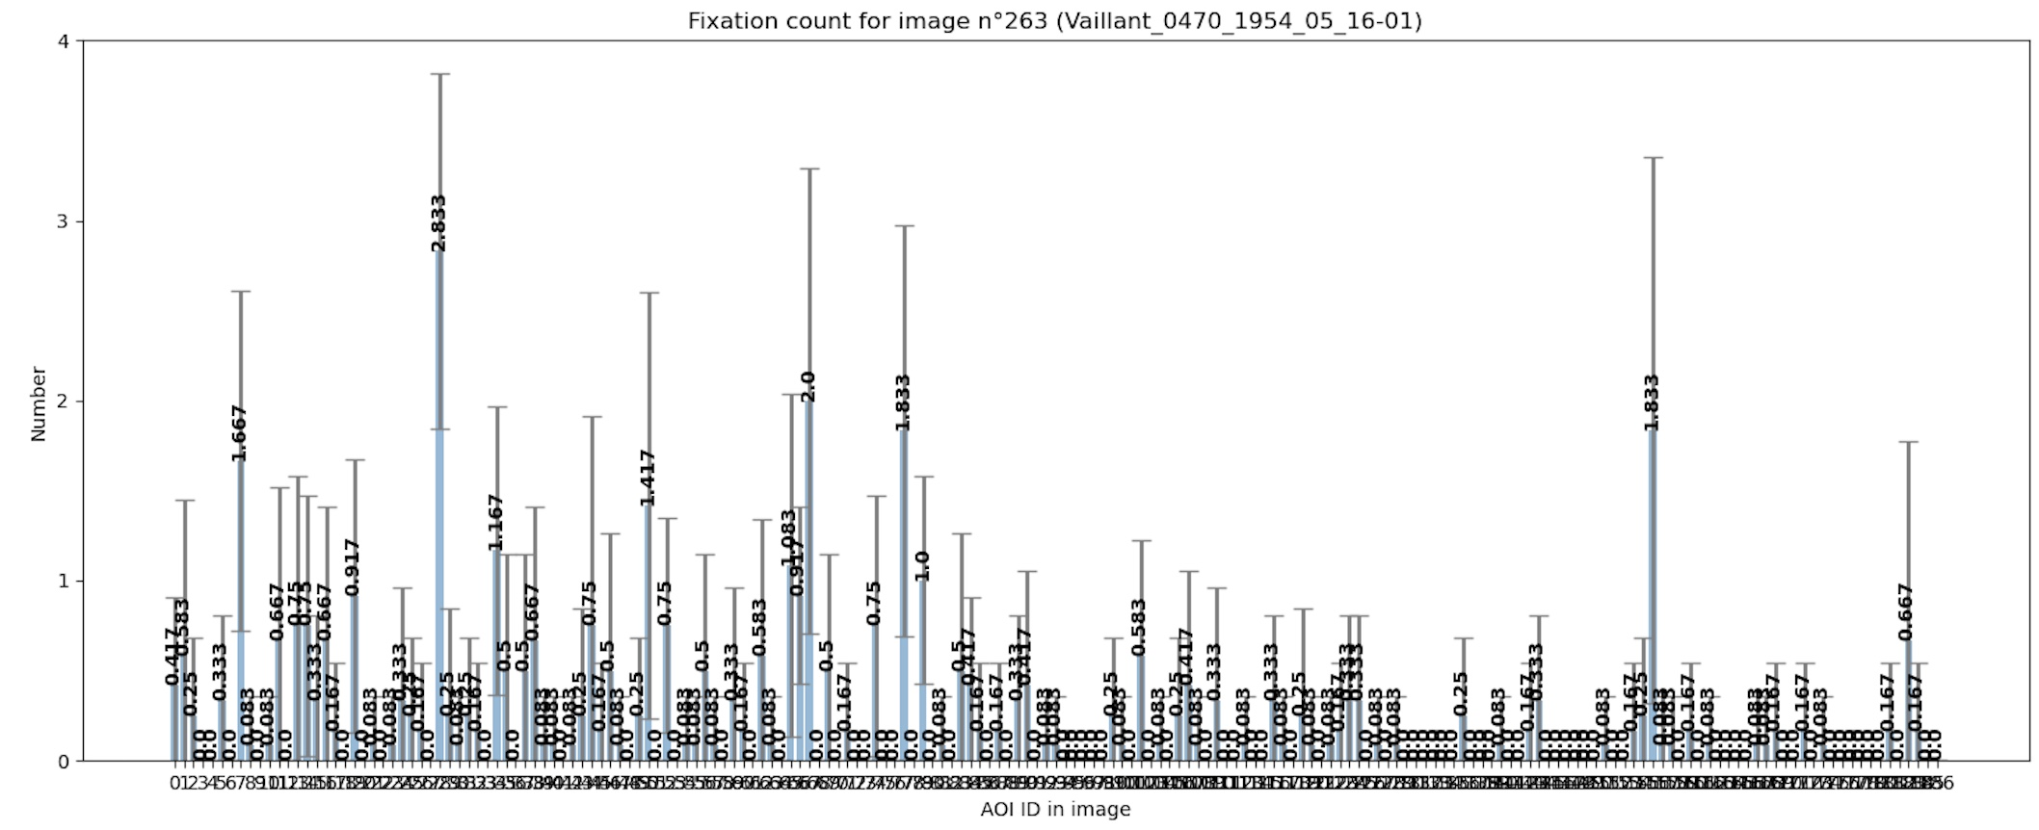
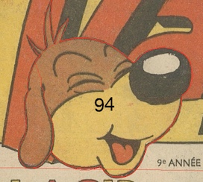
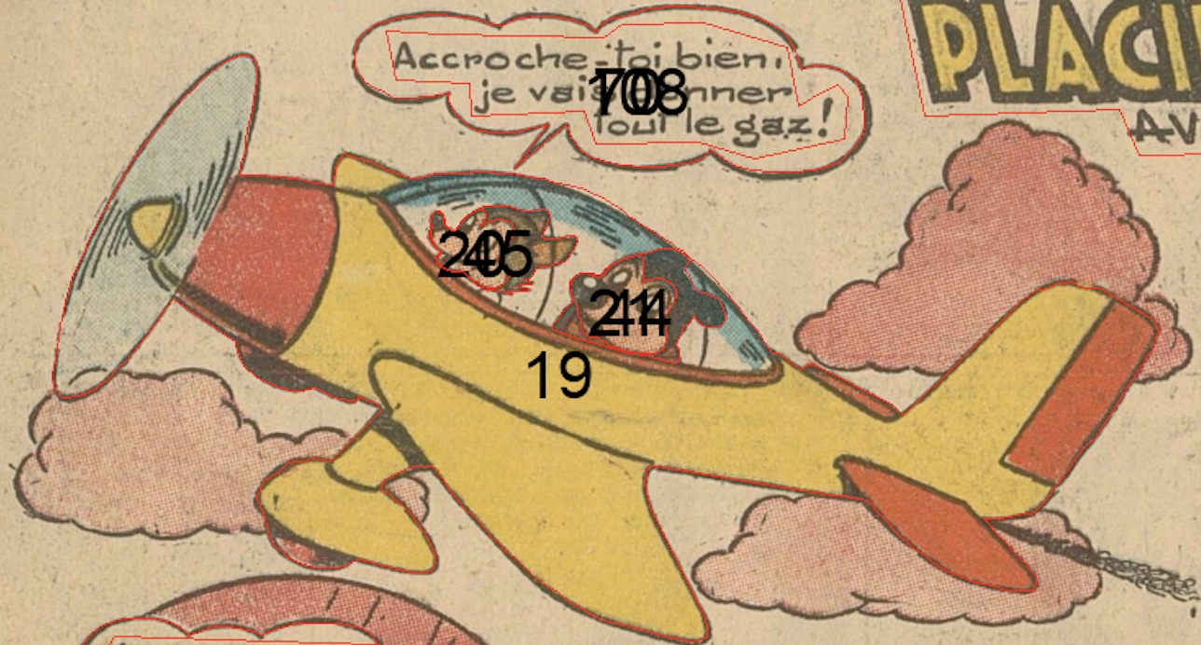
Working with the new AOIs
Redefinition of the AOI’s definition to match with the json file’s attribute.
Efficiently draw the aois on the images.
Based on position of the fixation say which aoi it is on.

Slide 3
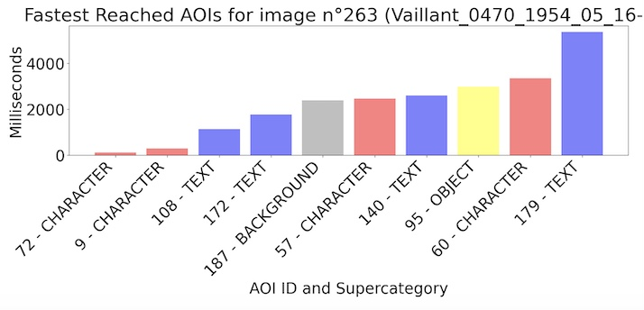
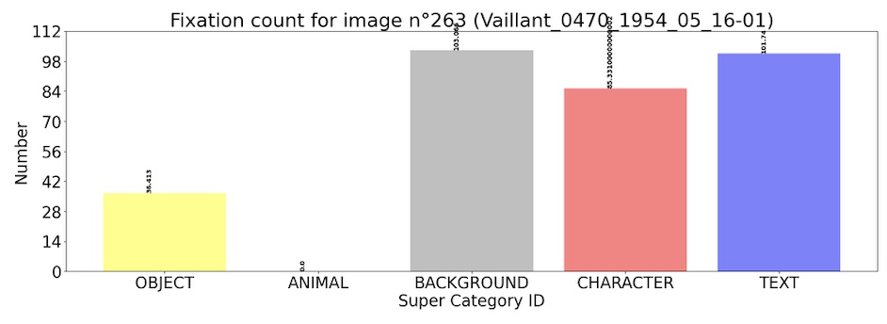
Histograms by Super Category
Additional Visualization : Where do you look first ?
Divided the AOIs in 5 « super » categories : Text, Object, Animal, Character, Background.
Object
Generic Object (1) Boat (7)
Car (2) Train (8)
Bus (3) Chair (9)
Bicycle (4) Sofa (10)
Motorbike (5) Table (11)
Airplane (6) Plant (12)
Animal
Cat (13)
Dog (14)
Cow (15)
Horse (16)
Sheep (17)
Bird (18)
Generic Animal (19)
Character
Face (22)
Hand (23)
Character (28)
Background
Building (20)
Background (21)
Other
Text
Comic Bubble (26)
Text (27)

Slide 4
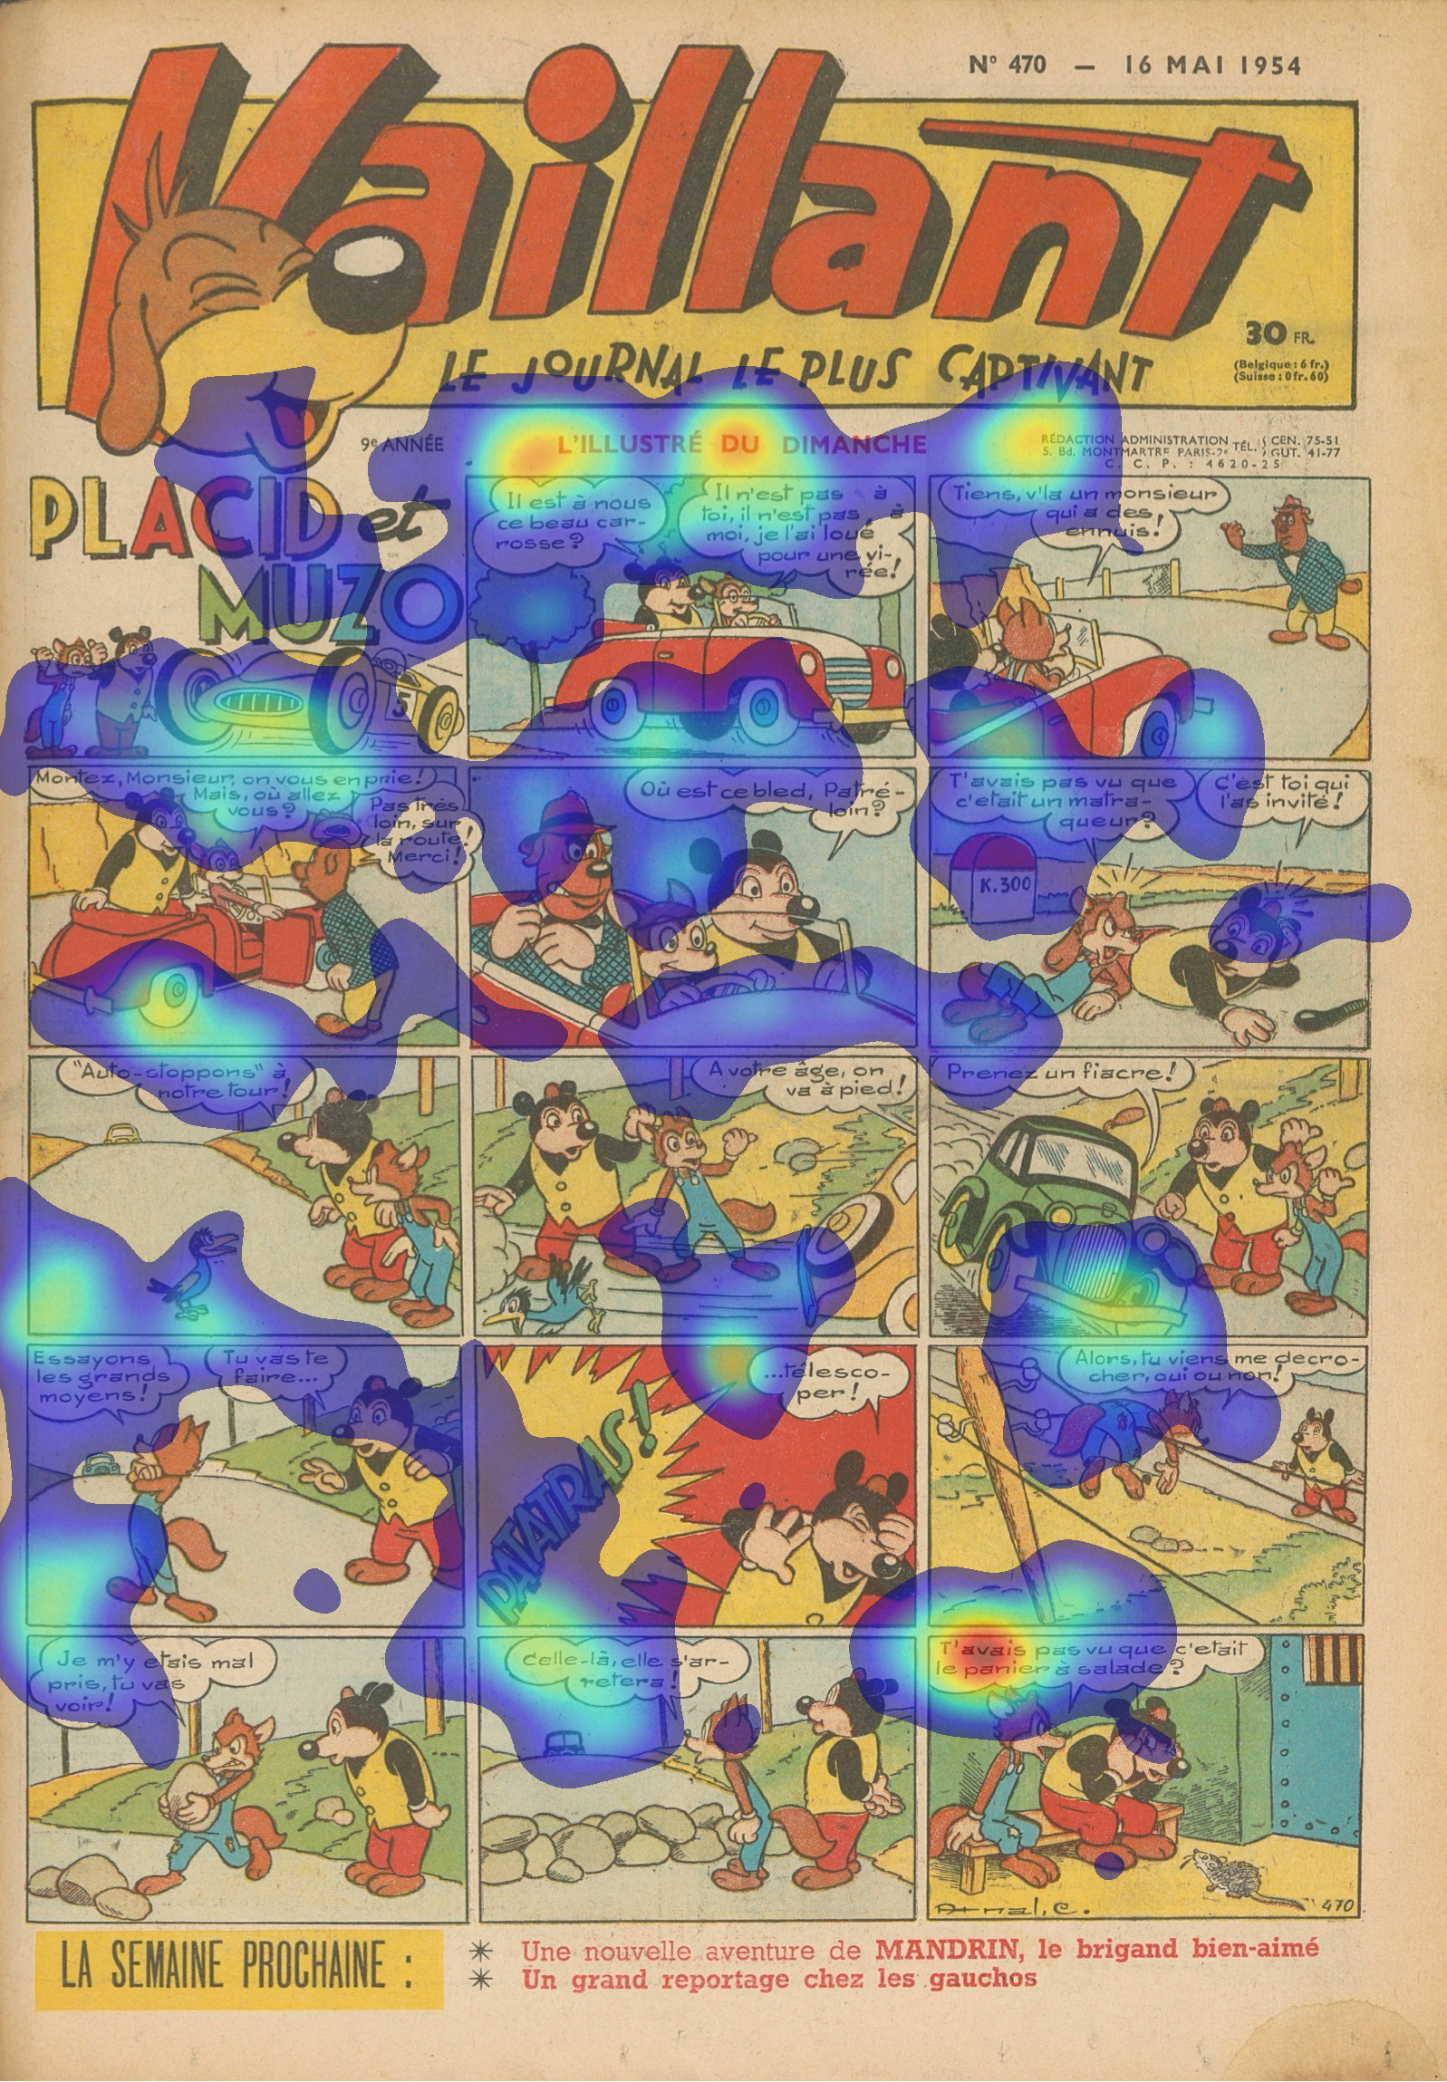
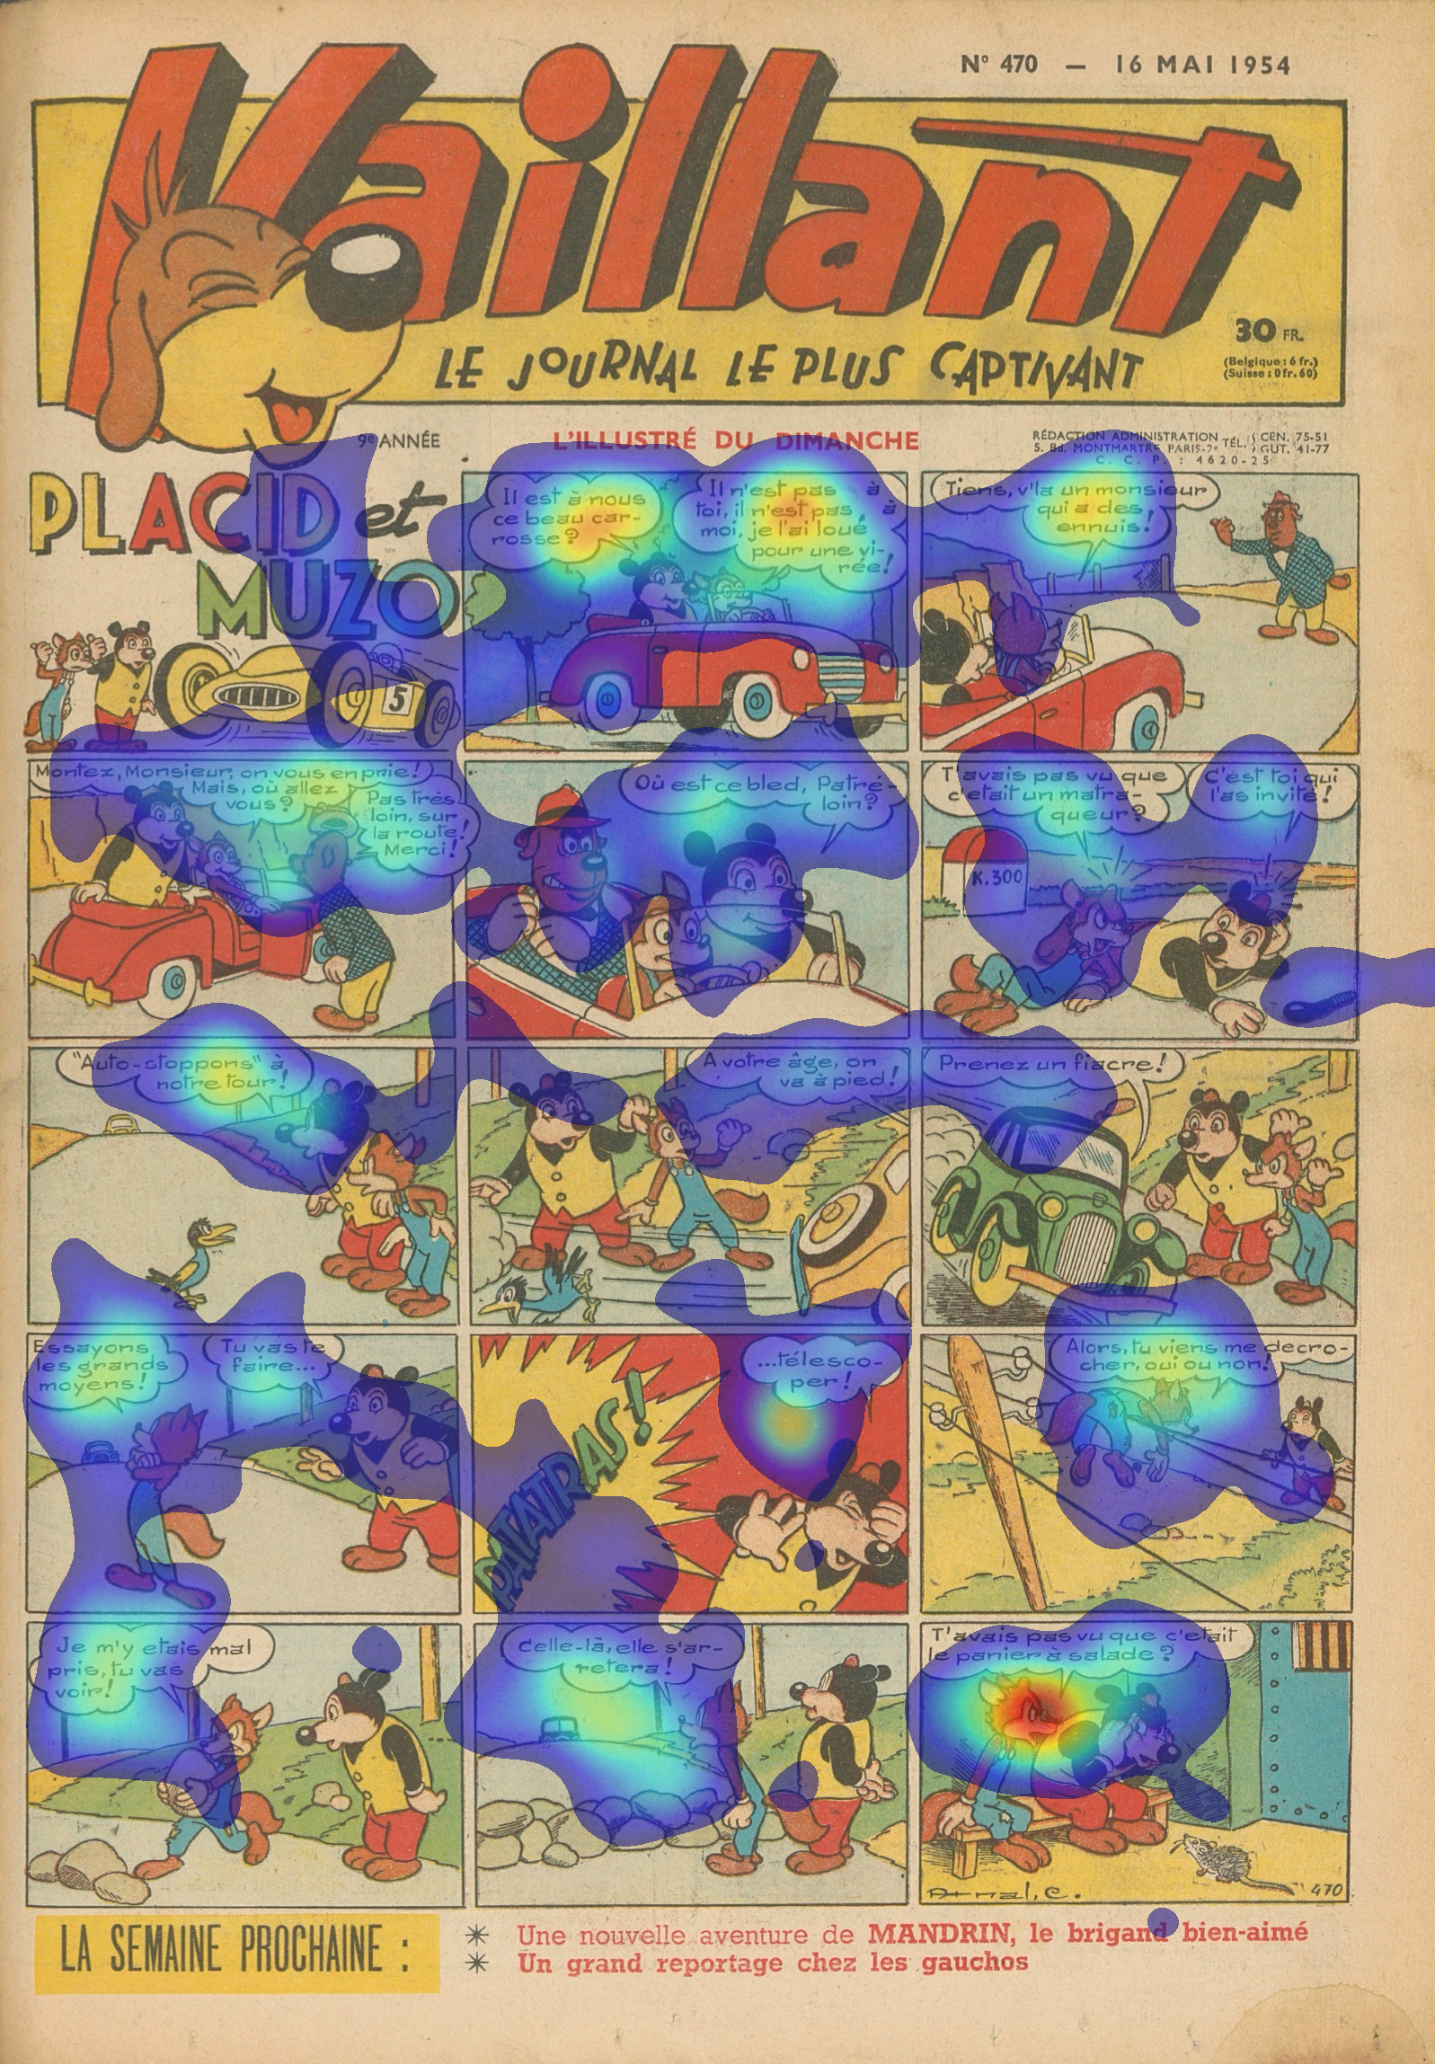
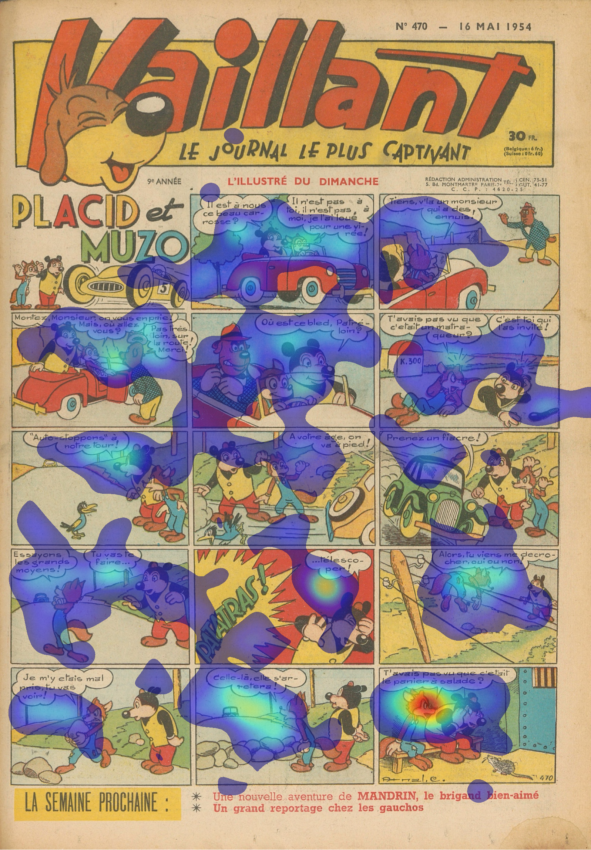
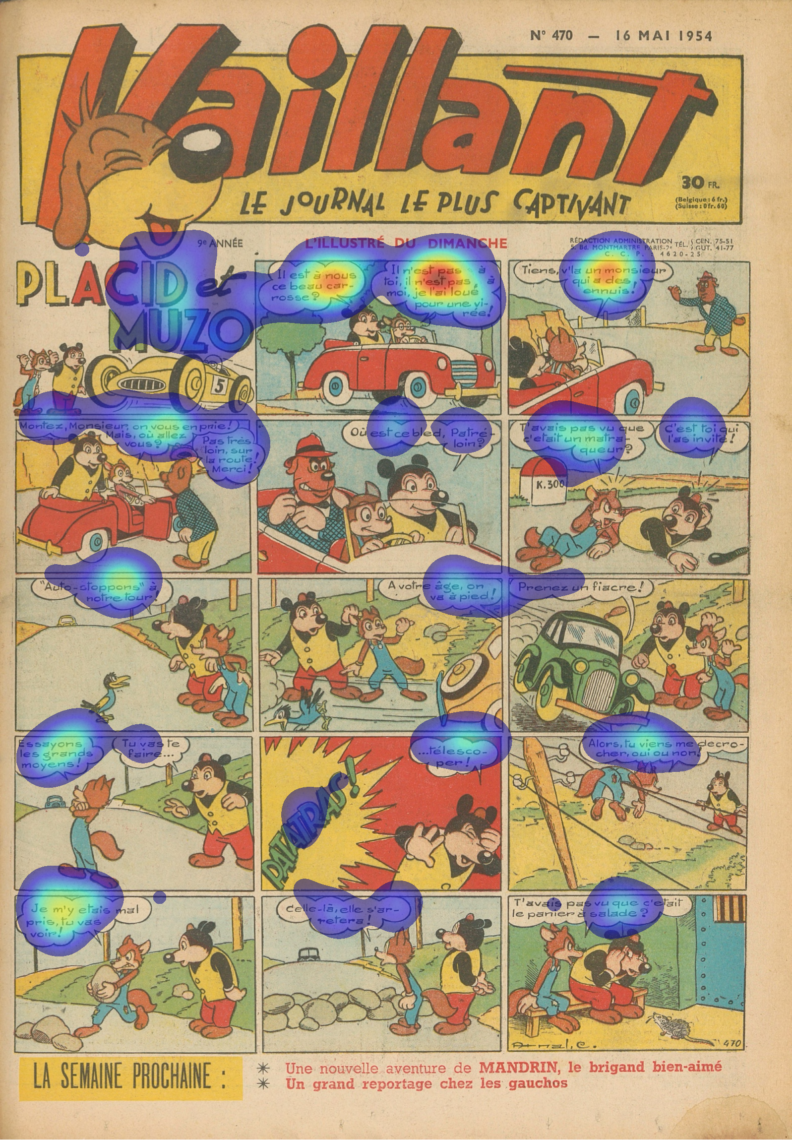
Heatmaps
Problems with the original code of the heatmaps.
Creation of two new heatmaps:
One without text
One only with text
All Fixations
Without Text
Only Text

Slide 5
Our Results and Challenges so far …
Text gathers most of our attention; it is therefore difficult to assess the importance of other elements.
Ranking of the AOI
Background everywhere
Working with code that is not ours

Slide 6
Future Goals
New ways to visualize data
Doing the eye-tracking experiment

